Slide 1


Minor Project - 1
Title: SharpView – Low Light Image Enhancement using C++
Presented by:
R2142220936 – Sagar Thapliyal
R2142221156 – Aviral Khanna
R2142220937 – Saksham Siwach
R2142220447 – Arshdeep Kaur
Mentored by:
Mrs. Gaytri

Slide 2
Content
Introduction
Literature Review
Objectives
Methodology
Working Model
Results
Conclusion
References

Slide 3
Introduction
Technical Background of Project:
Basic Image Processing Techniques:
Gaussian Smoothing: Removes noise from an image by applying a Gaussian filter blurring sharp edges and noise with losing significant detail.
Gamma Correction: Improves low-light images by enhancing the brightness and contrast.
Gray World Color Balance: Fuses RGB channels together so that the image looks more natural, reduces color distortions occurring at low lights, etc.
Project Implementation:
Developed completely in C++ for resource efficiency and optimized for low-end devices. The program avoids the dependency on external libraries that reduces overhead.

Slide 4
Technical Concepts (Algorithms) Used:
Image Processing – We will be first collecting low light images from different online as well as physical sources. As we are aware that, normally, the images exist in either JPEG format or PNG format, so we will be processing the images to convert them into PPM format. Then, after enhancing the image, we will be again converting the PPM images to JPEG format.
Image Enhancement – Starting this with smoothening, which will reduce excessive Gaussian Noise from the image. Then, Gamma Correction, will be implemented to enhance contrast and brightness of the image. Then, we will be using Gray-World Color Correction and Balance Adjustment technique to enhance the color intensities of the image, to achieve the final output.
Continuous Feedback – We will be asking for the user, whether he/she wants to enhance the image further or not. If user wants to enhance further, the brightness, contrast and shadows of the image gets adjusted and new refined image is produced as an output. On the other hand, if user denies for further improvements in the image, the code execution ends.

Slide 5
Motivation:
Real-Life Use Case – Can be used to enhance images captured at night or in low-light conditions, which can be very beneficial in terms of safety and security.
For Low-End Devices – As it uses no external libraries or dependencies, it has very less overhead on the machine and eventually it has a fast processing pipeline. As a result, can also be used easily on a low end device.
Deeper Understanding of Image Enhancement Concepts – As we are implementing each and every technique from scratch, we will gradually develop a greater understanding of each technique and it would benefit us in longer run to work on other image related projects.
Problem Statement:
Many digital images, particularly those captured in suboptimal conditions such as low-light, suffer from quality issues such as low brightness, inadequate contrast, noise, and blurriness. Such degraded images are less useful for analysis or viewing. While there are existing solutions and number of applications to enhance images, they often rely on external libraries, which may not be practical for lightweight applications or environments with limited resources.

Slide 6
Area of Application:
This project can be beneficial in multiple areas like:
Surveillance Systems: In enhancing low-light images captured by security cameras to improve visibility and ultimately contributing in increased safety.
Medical Imaging: In enhancing images for better diagnosis and analysis which are blurry/ not clear due to some reasons or captured under low-light conditions.
Mobile Photography: Improving quality of the pictures that are distorted or captured in poor lighting. Especially useful for low-end devices.
Forensics: Enhancing pictures from crime scenes, which have been taken in dim light conditions, ultimately revealing more details.
Remote Sensing: Improving images captured from drones or satellites during night operations.
Dataset and Input Format:
Dataset: ExDark Dataset, which is the collection of low-light images from various sources, is being used during the testing phase of the project. Otherwise, real-time image data will be used.
Input Format: The input images should be in the PPM format, containing raw RGB pixel data, which can be processed directly by the C++ program without using external libraries.

Slide 7
Literature Review
Cite Related Work:
Histogram Equalization Methods: Global Histogram Equalization (GHE) enhances the contrast but suffers from over-amplification of the high-frequency gray levels, and thus the problem is reduced by Local Histogram Equalization (LHE), which introduces noise and over enhancement.
Dynamic Histogram Equalization (DHE): DHE divides the histogram into sub-histograms to balance the contrast, especially in medical and satellite imaging.
Recursive Mean-Separate Histogram Equalization (RMSHE): RMSHE has been found to effectively enhance underwater and low light images but introduces noise. One of the Learning-based approach, Deep learning performs far better than traditional methods such as Retinex, but suffers from bias due to training data.
DiffLight: CVPRW 2024 : This one of the latest models which uses a diffusion process for noise removal and a UNet Transformer for improving low-light images. The model does very well in nighttime photography.
Inference from Literature:
Limitations of Classical Techniques: While there is a clear benefit of the classical techniques in relation to PPM that is introduced by Global Histogram Equalization, over-amplification is one of the greatest challenges imposed by this technique, similar to the artifacts which may arise during simple pixel-level manipulations in the PPM image processing pipeline.
Advanced Techniques for Contrast Enhancement: Advanced techniques like Contrast Adjustment in this regard have better control with lesser side effects, similar to the contrast adjustment capabilities with the PPM image enhancement project.
Pixel-Level Processing: Gaussian Smoothing and Gamma Correction make the images noise-free and increase brightness which are two main reasons for poor image qualities.
Application to Image Processing: In this project, the brightness of an image is improved and the contrast adjustment and shadow enhancement are also done to better use them in PPM format for viewing. Utilization of Gaussian Smoothing and other pixel-level manipulations in this project reflects the advanced techniques that are used in the modern image enhancement in order to achieve better visual outcome.

Slide 8




SWOT Analysis:
S
W
O
T
STRENGTHS
WEAKNESSES
OPPORTUNITIES
THREATS
Machine Independent
Versatility
Less Overhead on Machine
Accurate Computation
Error Prone
Tough Parameter Tuning
High Complexity
Basic UI
Improvements via Feedback Loops
Potential for Real-Time Applications
Educational Value
Competition with other libraries
Maintenance Challenge
Technology Shifts

Slide 9
Objective
Main Objective:
To design and implement a lightweight and robust C++ program that performs a variety of image enhancement techniques, which aims to improve the visual quality of degraded or distorted images(containing noise/ blur) captured in low-light conditions, that too without using any external libraries, and ensuring it is suitable for low-end devices (resource-constrained systems).
Sub Objective:
Enhance the quality of low-quality or noisy security footage to identify the subjects in the image, such as a likely thief.
Designs algorithms capable of enhancing specific regions in images which could be face or movement, for better recognition.
Optimizing the enhancement pipeline such that it would allow for real-time processing for enabling real-time detection of suspicious activity or people.

Slide 10
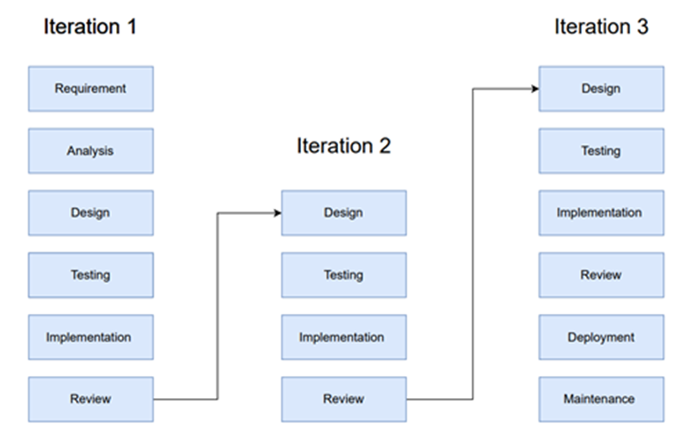
Methodology
Reference Software Model:
We will be using the Iterative Model to implement our project. The iterative method begins with a basic implementation of a limited set of software requirements in the iterative model, then repeatedly improves the evolving versions until the entire system is built and prepared for deployment.

Slide 11
Steps:
Initial Noise Reduction (Gaussian Smoothening): In this case to extract the region of interest we will be using renowned smoothing filter, Gaussian filter to remove noise from the image.
Gamma Correction: Gamma Correction will be used to modify brightness and local contrast of the image, simultaneously.
Gray World Color Correction: For color balance, the channels are tweaked so as to equalize color means, thus creating a naturally colored image.
Continuous Feedback Mechanism: For improvements, user feedback is taken and accordingly further enhancement is done. If user doesn’t need to enhance more, the code execution stops.
Iterative Refinement: Last but another enhancement technique that we have adopted is the utilization of Quality metrics (PSNR, SSIM) to enhance the quality of the image to better results.

Slide 12
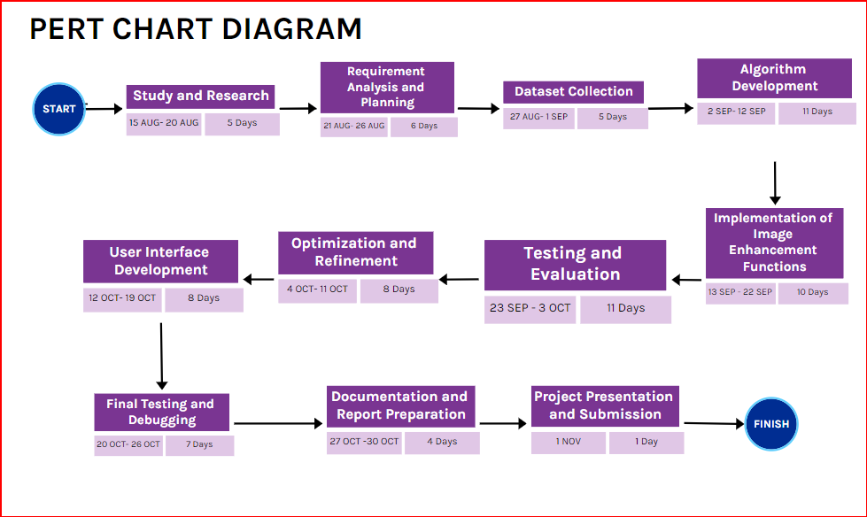
Timeline:

Slide 13
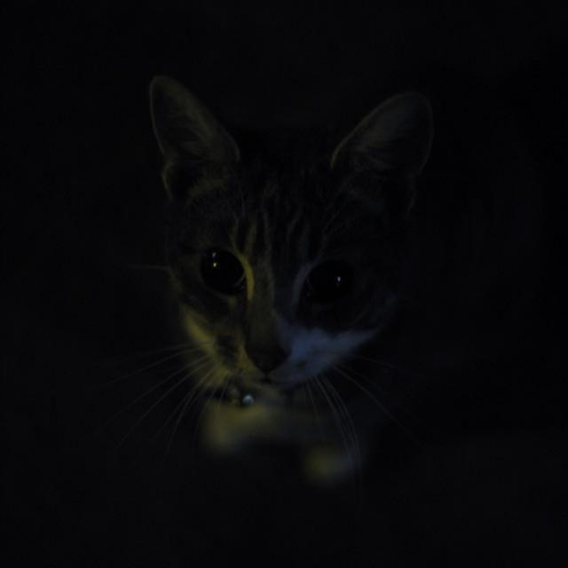
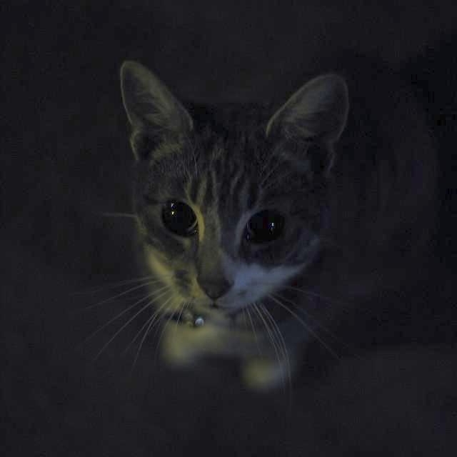
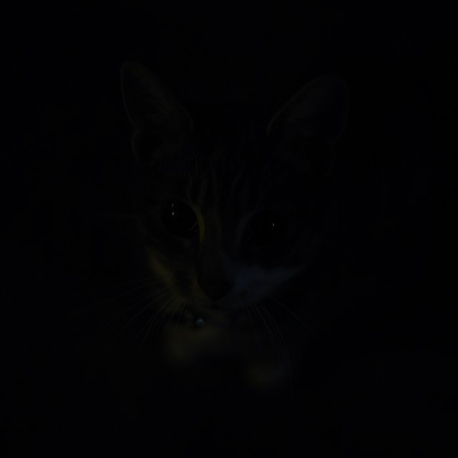
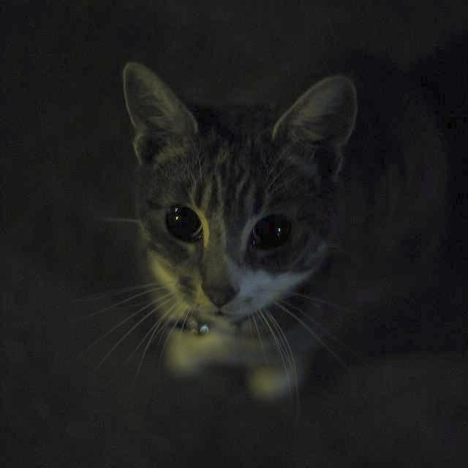
Deliverable of Each Step/Phase:
Gaussian Smoothening
Gamma Correction
INPUT IMAGE
Gray World Color Correction

Slide 14
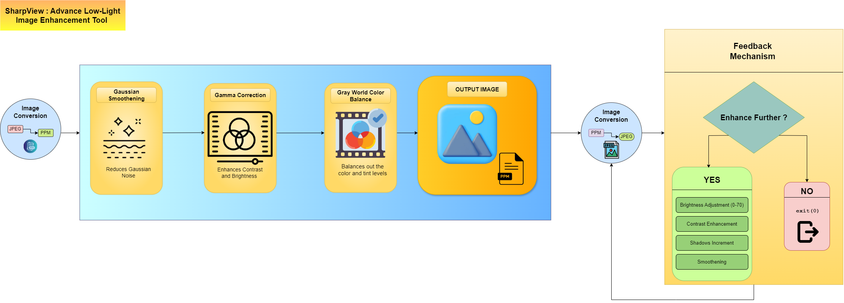
Working Model
Requirement Analysis (Link of SRS):
https://drive.google.com/file/d/1s31IgkIYVAj7Q8vYRS8Y_4ZVrgWz8FSg/view?usp=sharing
Technical Diagram:

Slide 15
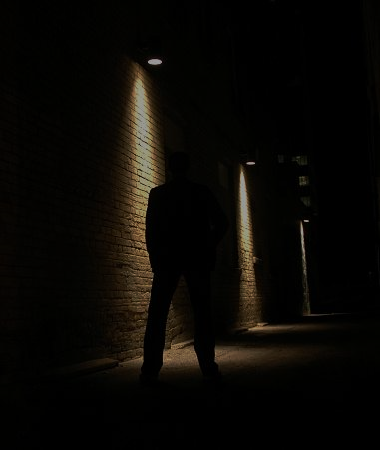
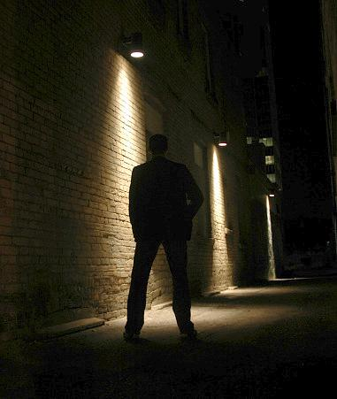
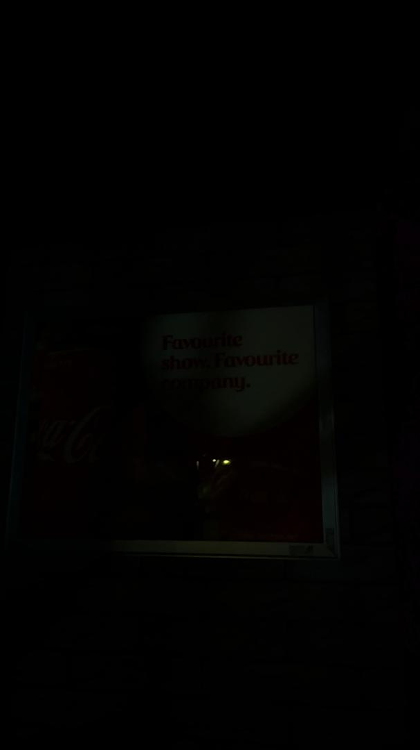
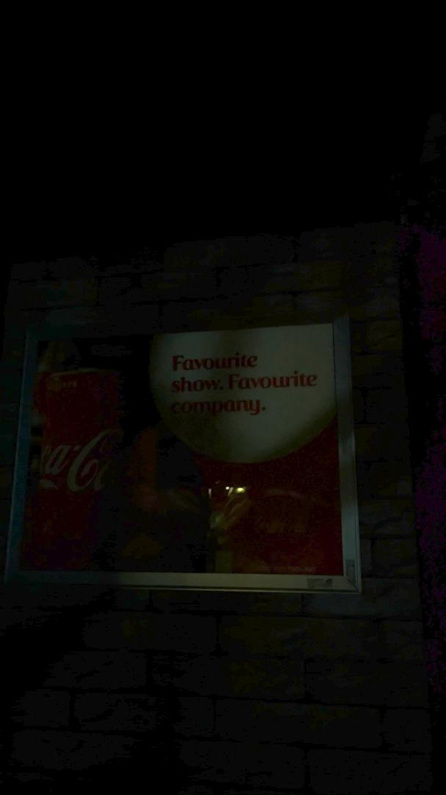
Working Module:
BEFORE
AFTER
BEFORE
AFTER
Real World Application
Real World Application

Slide 16
Working Module: (Contd...)
The project has made significant strides by successfully implementing file operations that allow us to read and write PPM files seamlessly. We developed a pixel structure using dynamic arrays, which efficiently stores RGB values and ensures smooth data handling throughout the process.
To enhance image quality, we applied Gaussian smoothing to reduce noise and implemented gamma correction to adjust brightness and contrast. To balance out color intensities, we have applied Gray World Color Balance. These techniques have greatly improved the visual clarity of the images. Looking ahead, we plan to introduce features that will give users greater control over brightness, contrast, and shadow adjustments, further enhancing the user experience.
We also established an intuitive workflow that makes it easy for users to input PPM files, apply necessary corrections, and save their processed images effortlessly. Additionally, we built robust error handling into the system to manage any file errors, unsupported formats, and gamma validation, ensuring a smoother overall operation.

Slide 17
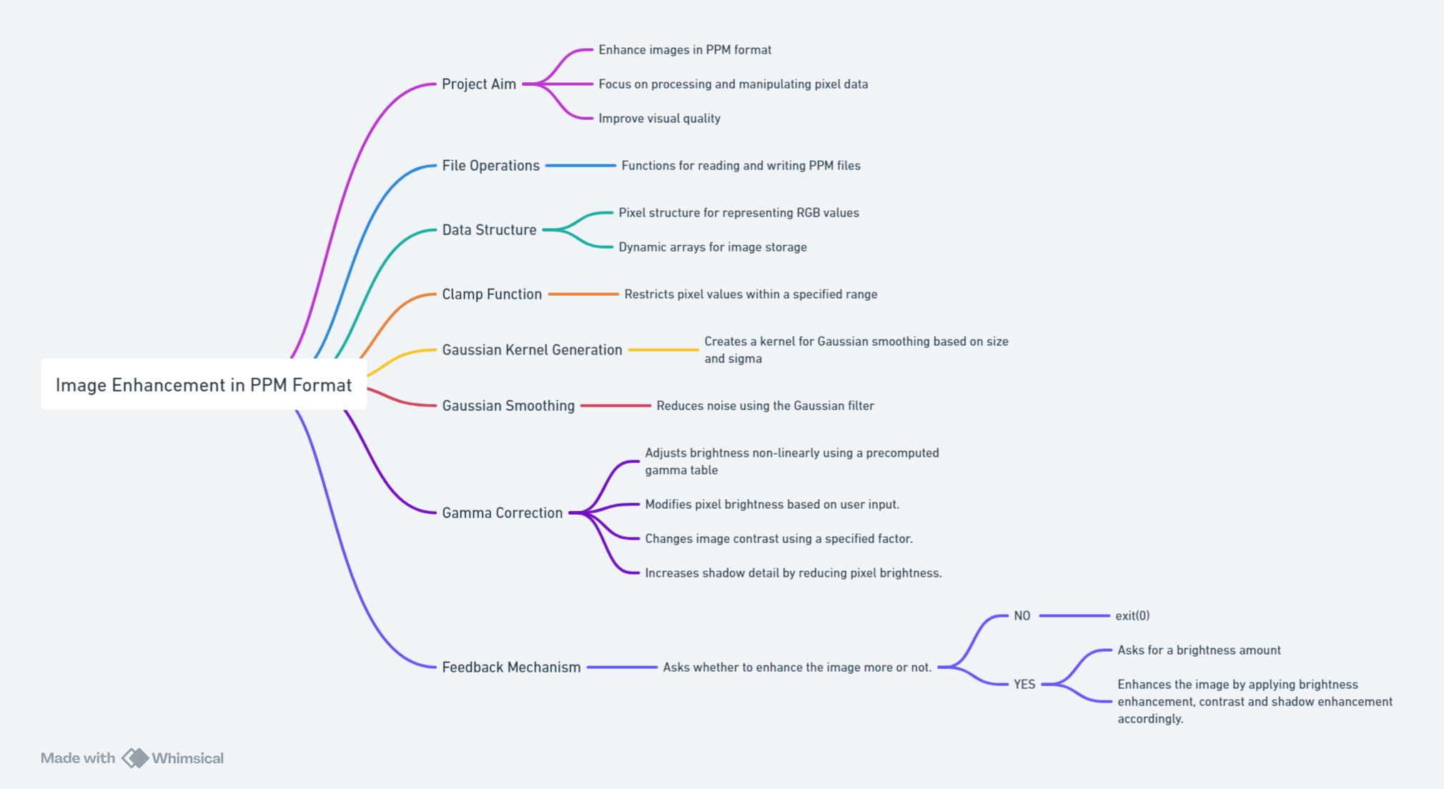
Working Module: (Contd...)

Slide 18
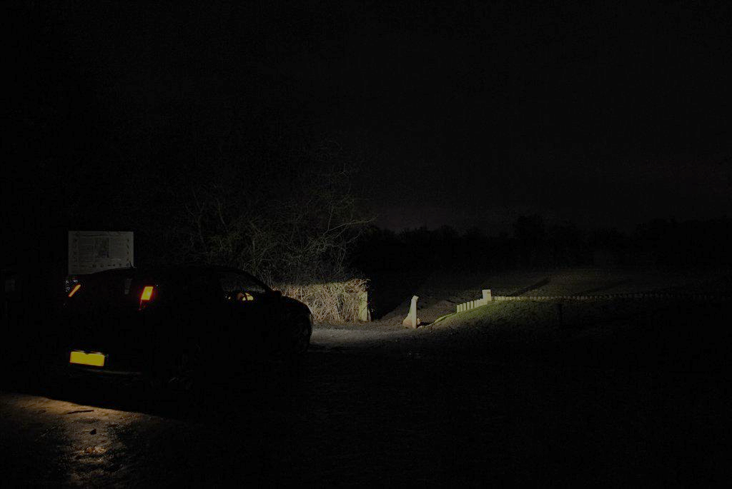
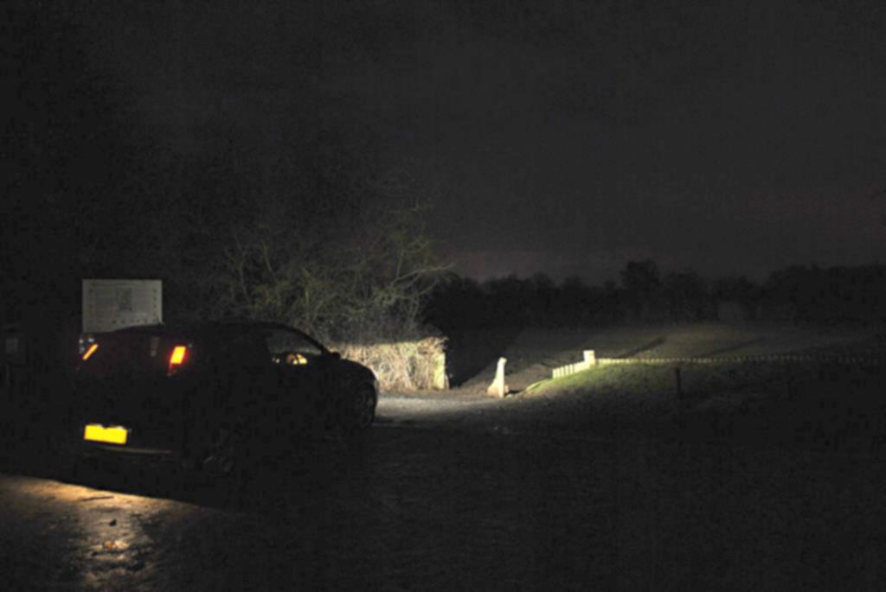
Attained Deliverable:
Input Image
Final Output Image

Slide 19
Results
Test Cases:
Image Quality Enhancement:
a) Objective: Check if image enhancement enhances brightness and visibility in low-lighting conditions.
b) Method: Compare original vs. enhanced images, visually and quantitatively, focusing on clarity and noise reduction.
Noise Reduction Accuracy:
Objective: Ensure the Gaussian smoothing algorithm reduces noise without blurring key details.
Method: Test with images of different levels of noise, check if the critical features of an image are preserved.
User Feedback Loop:
Objective: Test whether the user can iterate over the levels of enhancement for images (brightness, contrast, shadows).
Method: Test if the feedback of the user is suitably changing the parameters of the image in real time and if it captures the changes that are supposed to happen.

Slide 20
Outcome Graphs:
The objective of this study is to compare the effectiveness of four image enhancement techniques: Gamma Correction, Gaussian Smoothing, Gray World Color Correction, and Iterative Processing, in terms of two significant metrics:
Peak Signal-to-Noise Ratio (PSNR): Evaluates the quality of the enhanced image with respect to the original one.
Structural Similarity Index (SSIM): Measures the structural similarity between enhanced and original images.
Methodology
Dataset: A set of images was processed using the four enhancement techniques, and the results were analyzed using PSNR and SSIM metrics.
Enhancement Techniques:
Gamma Correction: Adjusts brightness through the transformation of pixel values using a power-law relationship.
Gaussian Smoothing: Reduces noise and improves the smoothness of an image using a Gaussian filter.
Gray World Color Correction: Balances color levels based on the assumption that the average color of a scene is gray.
Iterative Processing: Applies repetitive improvements to the image’s quality with every iteration.
Metrics:
PSNR: A higher PSNR value indicates higher quality and similarity to the original image.
SSIM: A value closer to 1 means better structural similarity to the reference image.

Slide 21
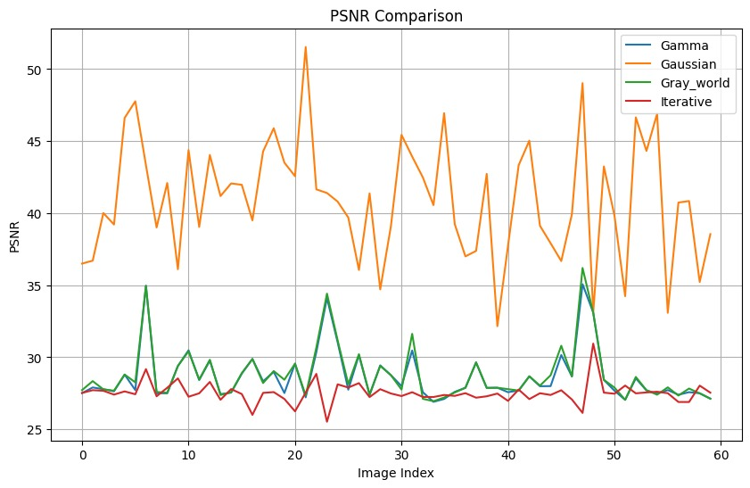
Outcome Graphs: (Contd…)
PSNR Comparison
Gaussian Smoothing:
Achieves the highest PSNR values across the dataset, with significant peaks above 40, reflecting its superior ability to enhance image quality while minimizing noise and distortion.
Exhibits variability, indicating sensitivity to different image properties.
Gray World:
Demonstrates steady PSNR performance, frequently ranking second to Gaussian Smoothing.
Balances enhancement while preserving the original image quality.
Gamma Correction:
Maintains consistent PSNR values with minimal fluctuations throughout.
Provides moderate enhancement but does not outperform Gaussian or Gray World techniques.
Iterative Processing:
Produces the lowest PSNR scores, indicating minimal enhancement or higher deviations from the original images.
Stability in PSNR suggests a less intensive enhancement approach.

Slide 22
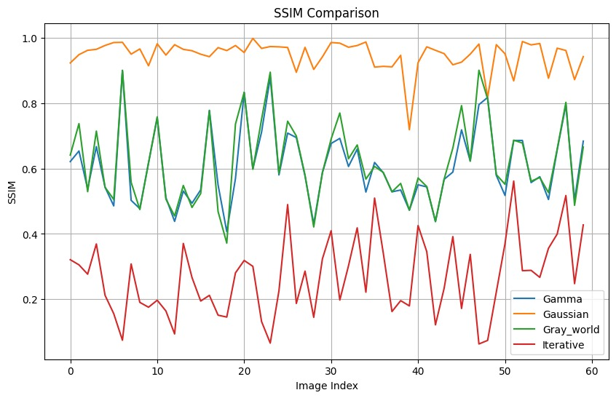
Outcome Graphs: (Contd…)
SSIM Comparison
Gaussian Smoothing:
Maximizes SSIM, consistently reaching values near 1, highlighting its ability to retain structural details.
Ideal for applications where structural similarity is critical.
Gray World:
Achieves good SSIM values, though slightly less consistent than Gaussian Smoothing.
A reliable option for color correction tasks.
Gamma Correction:
Produces stable SSIM values, slightly below those of Gray World and Gaussian.
Effective for brightness adjustments but less robust in preserving structural similarity.
Iterative Processing:
Displays the lowest SSIM values, indicating limited effectiveness in retaining structural integrity.
Optimization may improve performance.

Slide 23
Outcome Graphs: (Contd…)
Key Observations
Gaussian Smoothing is the most effective technique for achieving high PSNR and high SSIM.
Gray World Correction provides a balanced approach, with competitive PSNR and SSIM values.
Gamma Correction delivers moderate enhancement, suitable for brightness adjustments.
Iterative Processing consistently underperforms in both PSNR and SSIM, suggesting limited applicability in its current form.
Comparative Studies:
Histogram Equalization: Adjusts contrast by spreading out intensity values; ideal for low-contrast images.
Gaussian Smoothing: Reduces noise while preserving edges, suitable for pre-processing in recognition tasks.
Grey Color Correction: Enhances grayscale images by adjusting intensity for better contrast and uniformity, useful in enhancing details in low-light or unevenly lit images.
Feedback: Tailors enhancements to local regions, effective in handling varying illumination.

Slide 24
Conclusion
Justification of Objectives:
Image enhancement is critical in fields like medical imaging, satellite image analysis, and surveillance for improving visual quality.
C++ offers performance advantages, precise control over memory, and portability, making it ideal for high-efficiency, hardware-independent image processing across diverse systems.
Objectives:
To compare different image enhancement algorithms and evaluate their effectiveness, efficiency, and resource independence when implemented in C++.
Future Scope:
Integrating AI-driven enhancement algorithms for real-time applications.
Optimization of existing methods to handle larger images or video streams efficiently.
Extending C++ implementations to support parallel computing for faster processing on multicore or GPU-based systems.

Slide 25
Reference
List of Cited Papers:
[1] A Dynamic Histogram Equalization for Image Contrast Enhancement M. Abdullah-Al-Wadud, Md. Hasanul Kabir, M. Ali Akber Dewan, and Oksam Chae, Member, IEEE
[2] Gray World based Color Correction and Intensity Preservation for Image Enhancement N.M. Kwoka, D. Wanga, X. Jiab, S.Y. Chenc, G. Fangd and Q.P. Hae aSchool of Mechanical and Manufacturing Engineering The University of New South Wales, Australia bSchool of Information Technology and Electrical Engineering The University of New South Wales, Australia cCollege of Computer Science Zhejiang University of Technology, 310023 Hangzhou, China dSchool of Engineering University of Western Sydney, Australia eSchool of Electrical, Mechanical and Mechatronic Systems University of Technology Sydney, Australia
[3] Low-Light Image Enhancement: A Comparative Review and Prospects WONJUN KIM , (Member, IEEE) Department of Electrical and Electronics Engineering, Konkuk University, Seoul 05029, South Korea
[4] DiffLight: Integrating Content and Detail for Low-light Image Enhancement Yixu Feng1 Shuo Hou1 Haotian Lin1 YuZhu1 PengWu1 WeiDong2 Jinqiu Sun1 Qingsen Yan1† Yanning Zhang1 1Northwestern Polytechnical University 2Xi’an University of Architecture and Technology
[5] M2Trans: Multi-Modal Regularized Coarse-to-Fine Transformer for Ultrasound Image Super-Resolution Zhangkai Ni, Member, IEEE, Runyu Xiao, Wenhan Yang, Member, IEEE, Hanli Wang, Senior Member, IEEE, Zhihua Wang, Lihua Xiang, and Liping Sun

Slide 26
Thank You

